Slide 1
Completion time or Makespan or Schedule Length: It is the total time taken to process a set of tasks for its complete execution.
Speedup: It is the ratio between the results obtained by assigning all tasks to a processor that gives the minimum completion time and the results obtained by executing tasks in parallel.
Efficiency: It is the ratio between the obtained speedup results and the total number of processors used.
Throughput: It is defined as the number of tasks executed per unit of time.
Utilization: it is the ratio between the total busy time of virtual machine and the total finish execution time of the parallel application

Slide 2
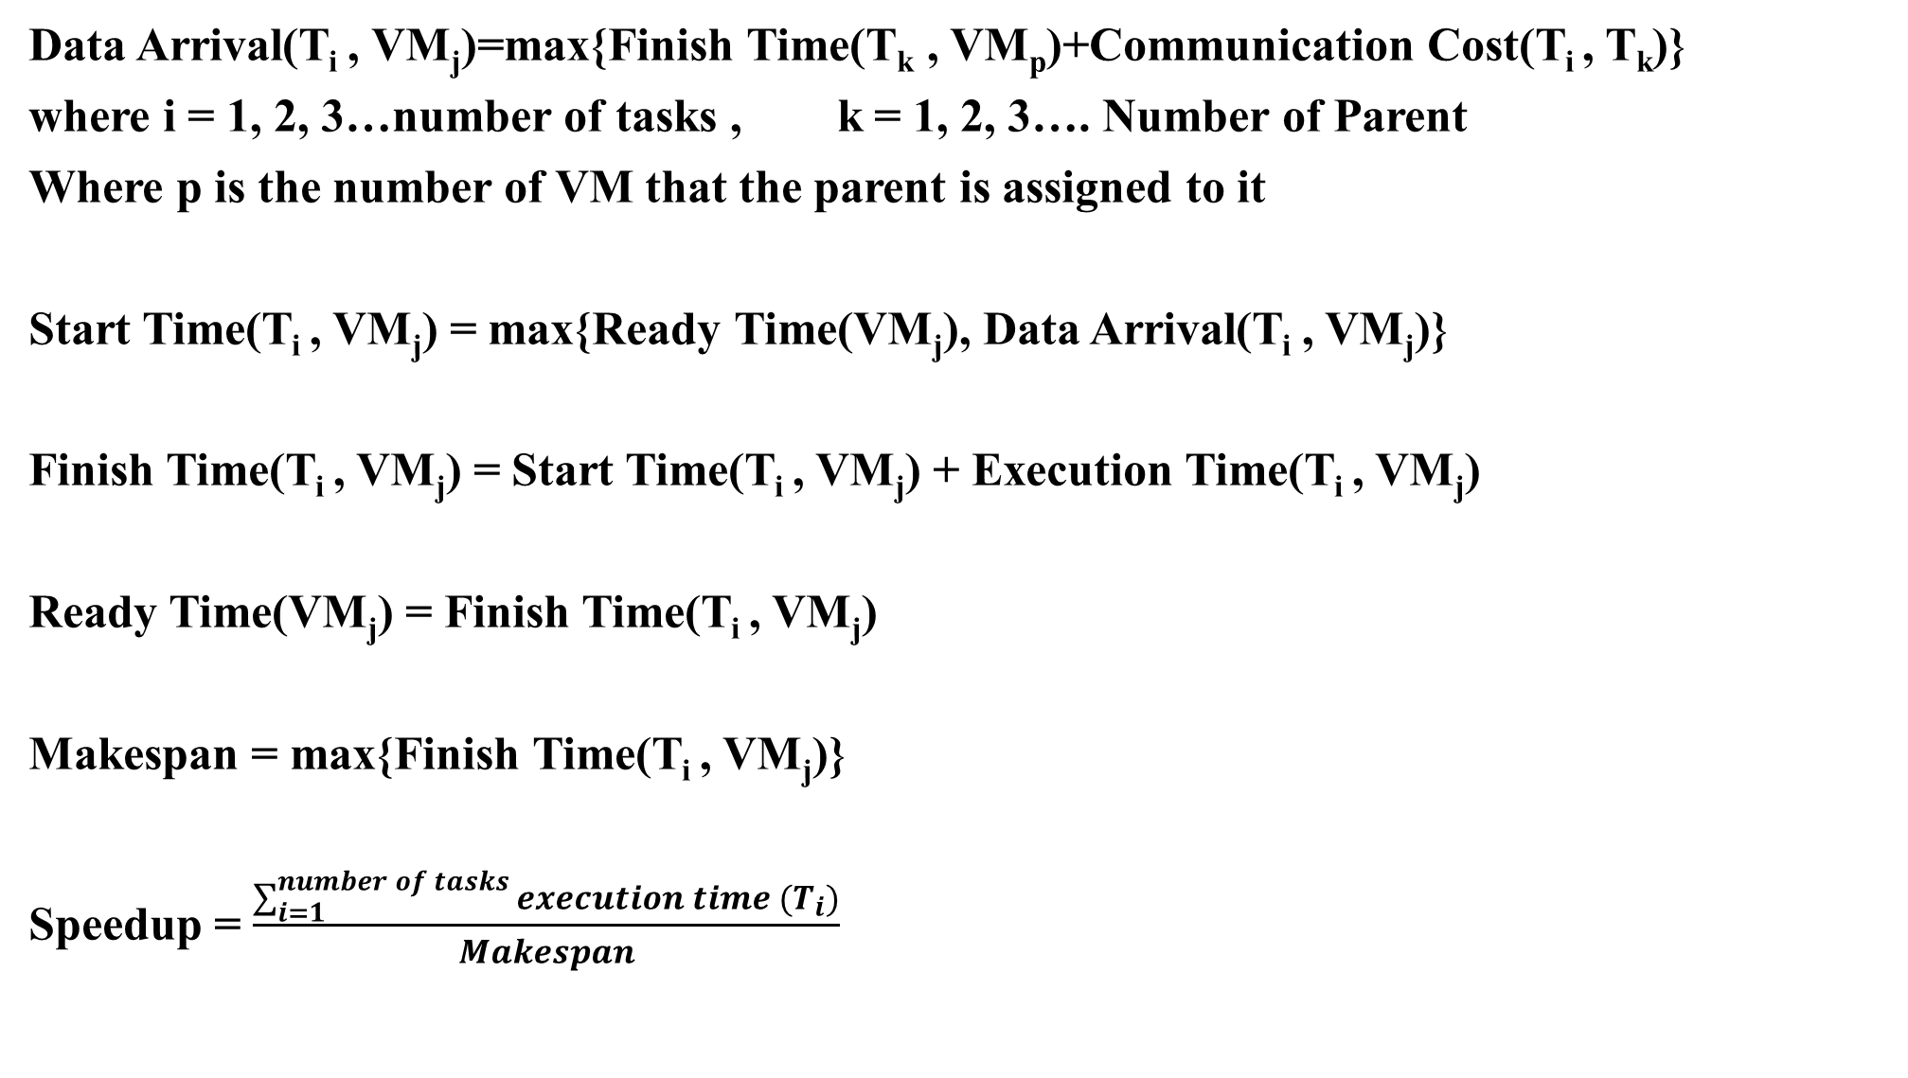
Data Arrival(T_{i} , VM_{j})=max{Finish Time(T_{k} , VM_{p})+Communication Cost(T_{i} , T_{k})}
where i = 1, 2, 3…number of tasks , k = 1, 2, 3…. Number of Parent
Where p is the number of VM that the parent is assigned to it
Start Time(T_{i} , VM_{j}) = max{Ready Time(VM_{j}), Data Arrival(T_{i} , VM_{j})}
Finish Time(T_{i} , VM_{j}) = Start Time(T_{i} , VM_{j}) + Execution Time(T_{i} , VM_{j})
Ready Time(VM_{j}) = Finish Time(T_{i} , VM_{j})
Makespan = max{Finish Time(T_{i} , VM_{j})}
Speedup = $\frac{\sum_{i=1}^{number of tasks}{execution time (T_{i})}}{Makespan}$

Slide 3

Efficiency = $\frac{Speedup}{number of VM}$
Throughput = $\frac{number of tasks}{Makespan}$
Utilization = $\frac{\sum_{j=1}^{number of VM}{available time ({VM}_{j})}}{number of VM ∗Makespan}$ * 100

Slide 4
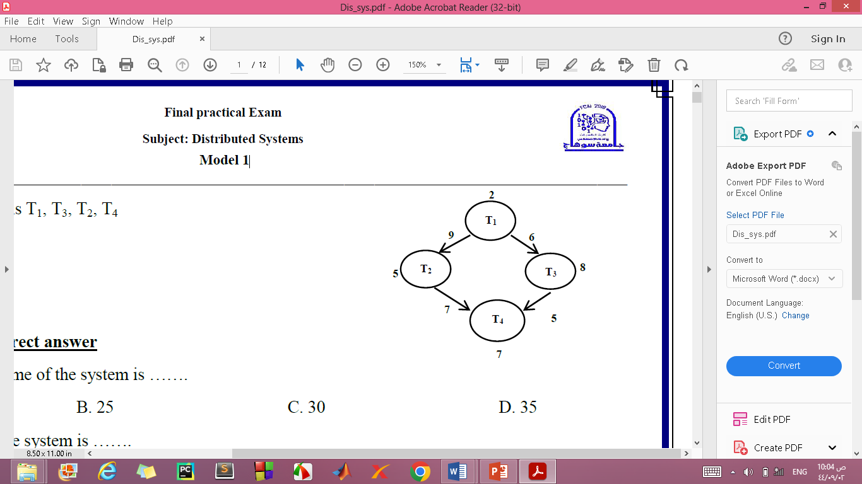
Suppose we have this example: it consists of four tasks, and the value written on the tasks refers to the execution time for the task, and the value written on edge refers to the communication between the task and its parents
Note that Virtual Machine (VM)
The priority is { T₁, T₃, T₂, T₄}
VM₁={T₁, T₃} VM₂={T₄}
VM₃={T₂}

Slide 5
We will begin our calculation based on the priority arrangements.
Note that for the first task that has no parents, the data arrival time is equal to zero.
Data Arrival(T₁ , VM₁)=max{Finish Time(T_{k} , VM_{j})+Communication Cost(T_{i} , T_{k})}
So Data Arrival(T₁ , VM₁) = 0
Note that the initial value of the ready time for all VMs is equal to zero.
So Ready Time (VM₁) = 0 , Ready Time (VM₂) = 0, and Ready Time (VM₃) = 0
Start Time(T₁ , VM₁) = max{Ready Time(VM₁), Data Arrival(T₁ , VM₁)}
Start Time(T₁ , VM₁)= max { 0, 0 } = 0

Slide 6
Finish Time(T₁ , VM₁) = Start Time(T₁ , VM₁) + Execution Time(T₁ , VM₁)
Finish Time(T₁ , VM₁) = 0 + 2 = 2
Ready Time(VM₁) = Finish Time(T₁ , VM₁) = 2 so the Reay Time of the VM₁ is updated from 0 to 2.
Note that if the parent and child are assigned to the same VM, the communication cost is equal to zero.
Data Arrival(T₃ , VM₁) = max{Finish Time(T₁ , VM₁) + Communication Cost(T₃ , T₁)}
Data Arrival(T₃ , VM₁) = max { 2 + 0 } = 2
Start Time(T₃ , VM₁) = max{Ready Time(VM₁), Data Arrival(T₃ , VM₁)}
Start Time(T₃ , VM₁) = max{ 2 , 2 } =2

Slide 7
Finish Time(T₃, VM₁) = Start Time(T₃ , VM₁) + Execution Time(T₃ , VM₁)
Finish Time(T₃, VM₁) = 2 + 8 = 10
Ready Time(VM₁) = Finish Time(T₃, VM₁) = 10
Data Arrival(T₂ , VM₃) = max{Finish Time(T₁ , VM₁) + Communication Cost(T₂ , T₁)}
Data Arrival(T₂ , VM₃) = max{ 2 + 9 } = 11
Start Time(T₂ , VM₃) = max{Ready Time(VM₃), Data Arrival(T₂ , VM₃)}
Start Time(T₂ , VM₃) = max{ 0 , 11 } = 11

Slide 8
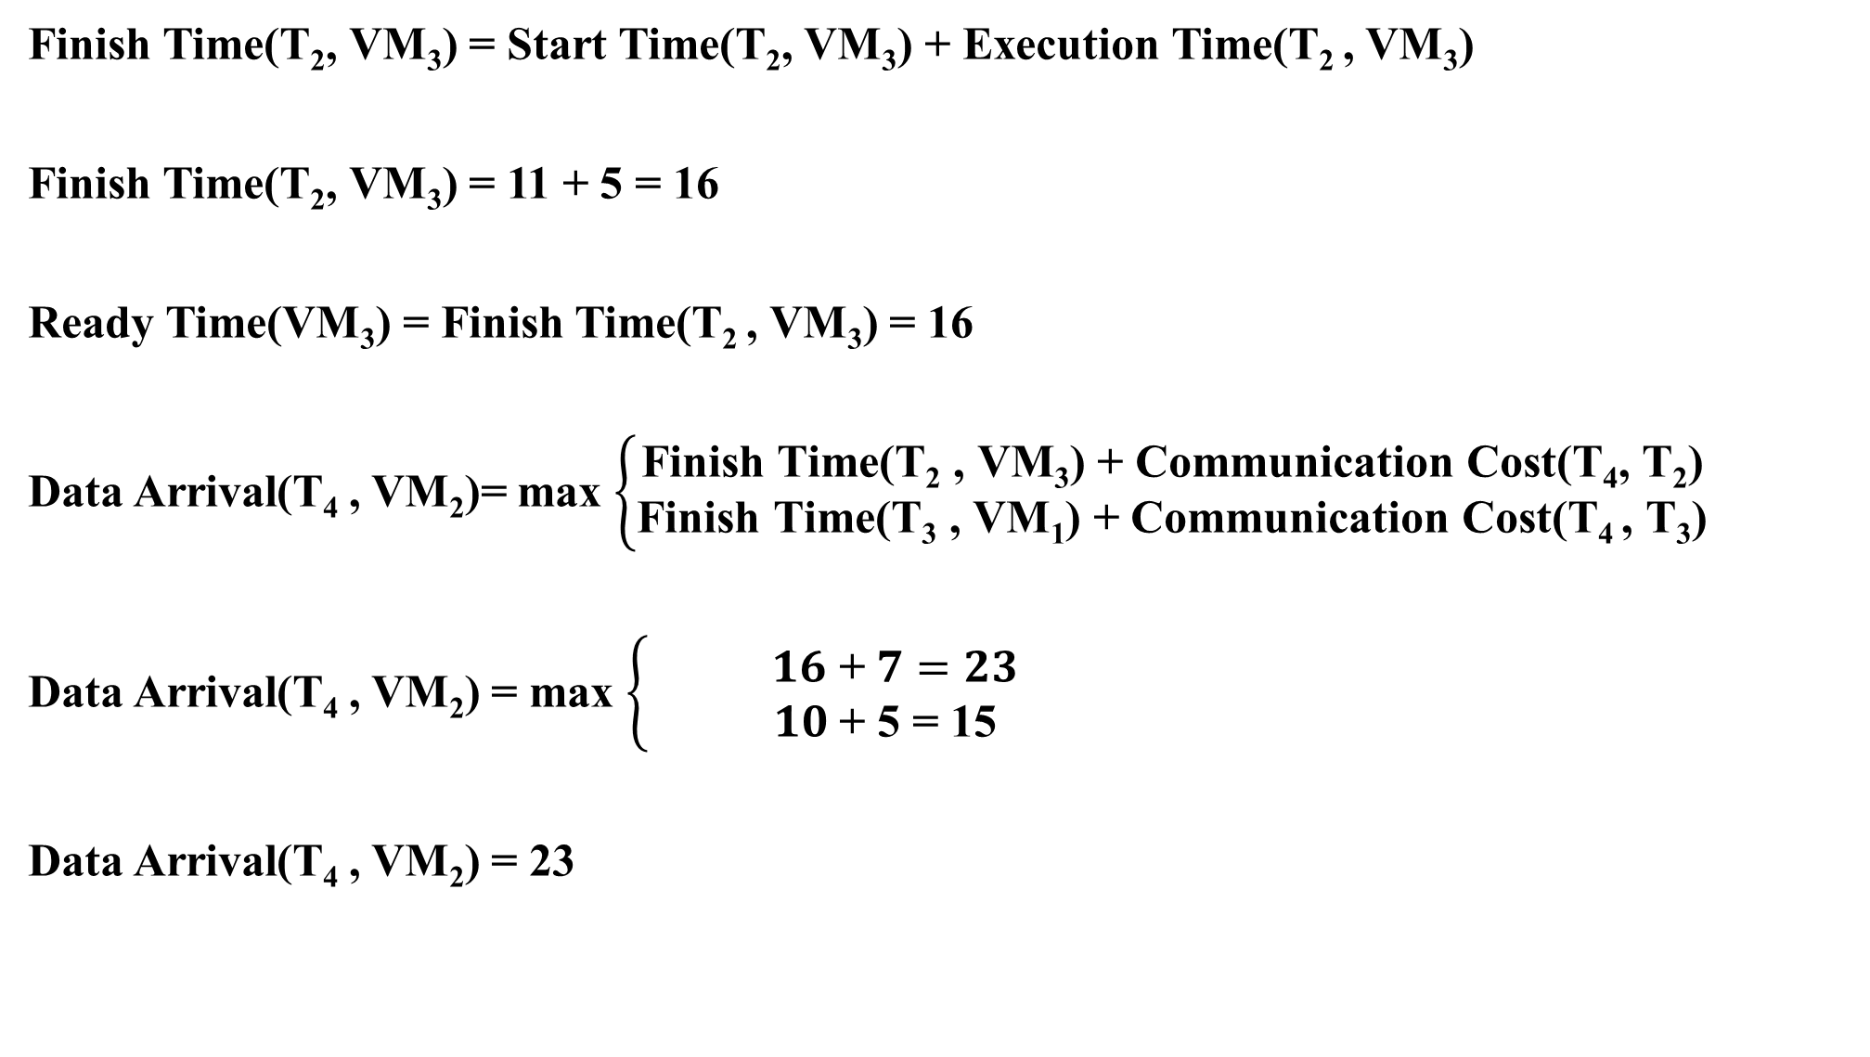
Finish Time(T₂, VM₃) = Start Time(T₂, VM₃) + Execution Time(T₂ , VM₃)
Finish Time(T₂, VM₃) = 11 + 5 = 16
Ready Time(VM₃) = Finish Time(T₂ , VM₃) = 16
Data Arrival(T₄ , VM₂)= max $\left\{\begin{aligned}\text{Finish} \text{Time}\text{(}\text{T}\text{2} \text{, }\text{VM}\text{3}\text{)} \text{+} \text{Communication} \text{Cost}\text{(}\text{T}\text{4}\text{, }\text{T}\text{2}\text{)} \\ \text{Finish} \text{Time}\text{(}\text{T}\text{3} \text{, }\text{VM}\text{1}\text{)} \text{+} \text{Communication} \text{Cost}\text{(}\text{T}\text{4 }\text{, }\text{T}\text{3}\text{)}\end{aligned}\right.$
Data Arrival(T₄ , VM₂) = max $\left\{ \begin{aligned} 16 \text{+} 7=23 \\ 10 \text{+} \text{5 }\text{= }\text{15 }\end{aligned}\right.$
Data Arrival(T₄ , VM₂) = 23

Slide 9
Start Time(T₄ , VM₂) = max{Ready Time(VM₂), Data Arrival(T₄ , VM₂)}
Start Time(T₄ , VM₂) = max{ 0 , 23 } = 23
Finish Time(T₄ , VM₂) = Start Time(T₄, VM₂) + Execution Time(T₄ , VM₂)
Finish Time(T₄ , VM₂) = 23 + 7 = 30
Ready Time(VM₂) = Finish Time(T₄ , VM₂) = 30

Slide 10

Makespan = max{Finish Time(T_{i} , VM_{j})} = 30
Speedup = $\frac{2+5+8+7}{30}$ = 0.73 Efficiency = $\frac{0.73}{3}$ = 0.24
Throughput = $\frac{4}{30}$ = 0.13
Tasks | Start Time | Finish Time
T₁ | 0 | 2
T₂ | 11 | 16
T₃ | 2 | 10
T₄ | 23 | 30

Slide 11

Busy Time = Finish Time – Start Time
Available Time = Makespan – Busy Time
Utilization = $\frac{\left(20+23+25\right) ∗100}{3 ∗30}$ = 75.5 %
Tasks | Start Time | Finish Time | VM | Busy Time | Available Time
T₁ | 0 | 2 | VM₁ | 10 | 20
T₂ | 11 | 16 | VM₂ | 7 | 23
T₃ | 2 | 10 | VM₃ | 5 | 25
T₄ | 23 | 30

